Slide 1
Personal Development and Intellectual Honesty
Day 1

Slide 2
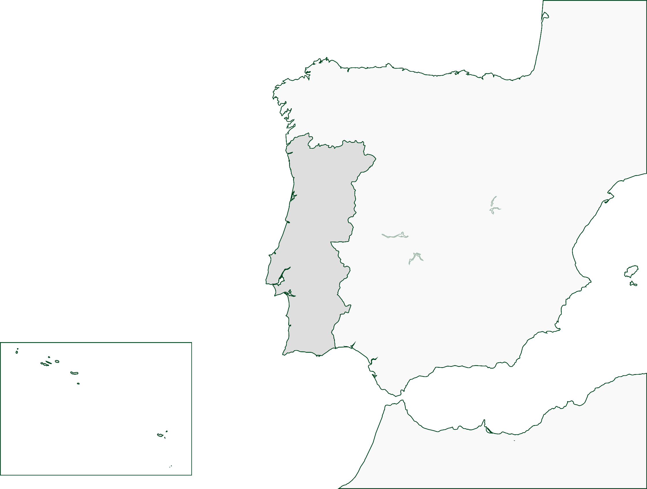
PORTUGAL
Our Context
France
88500Km²
Spain
PORTUGAL
Lisbon
Azores (9 islands)
2335 Km²
Madeira (2 islands)
796 Km²
Marrocos
Notes:
Let me give you some details on the context
Population: 11 millions

Slide 3
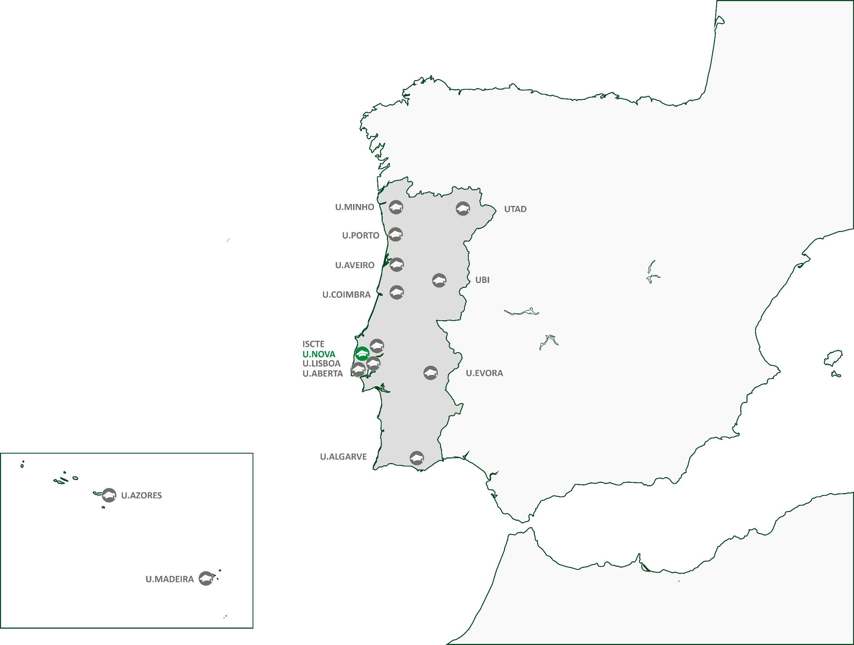
PORTUGAL
Portugal:
Public Universities
Notes:
14 public universities
Several private the most influential: the catholic university

Slide 4
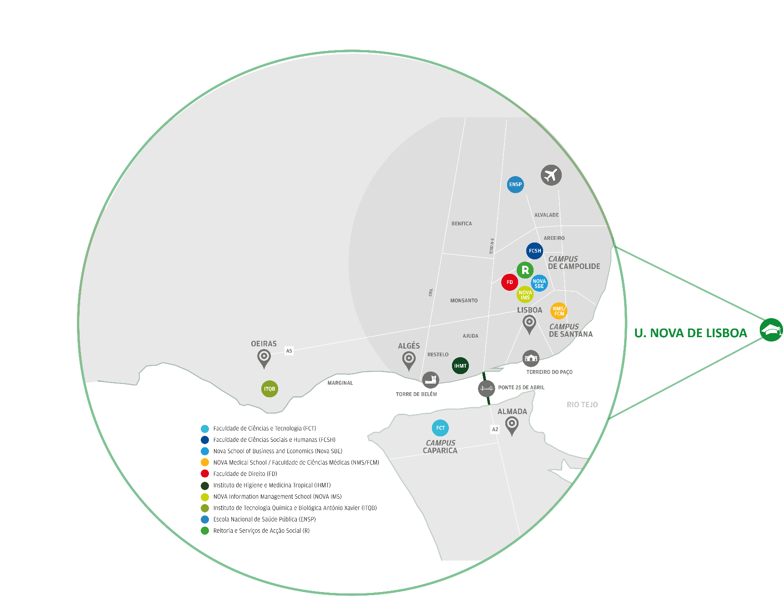
PORTUGAL
NOVA University Lisbon
19 800 Students
Notes:
U. NOVA DE LISBOA (9 Schools/campi on both sides of the river)
We are a very decentralised university with campi on both sides of the river and we are spreading we are building a new campus.
We have 9 schools we call Academic Units

Slide 5
The Team
Patrícia Rosado Pinto (Coordinator)
Elsa Caetano
Isabel Nunes
Joana Marques
João Sevilhano
Rita Falcão
Roberto Henriques

Slide 6
Expectations
(according to the CABCIN initial survey)
Intellectual honesty
Personal and professional development
Personal development plan aligned with the institutional mission

Slide 7
Content
1. Intellectual honesty:
1.1 Dimensions of intellectual honesty
1.2 Principles and values
1.3 Dilemmatic situations
1.4 Decision making
1.5 Beyond plagiarism
1.6 Academic Integrity: Teaching and learning approaches for intellectual honesty in higher education
2. Personal and professional development plan aligned with the institutional mission:
2.1 From group to team
2.2 Team building principles
2.3 Reflection on the institutional mission
2.4 The importance of individual and team roles

Slide 8
Aims
To identify different dimensions of academic integrity
To reflect on professional path
To identify personal and professional needs
To align these needs with the institutional mission

Slide 9
DAY 1
GROUP/TEAM DEVELOPMENT
Actions, roles, stages

Slide 10
Purposes of Day 1
To identify the roles played within a group/team
To discuss about group/team development
To reflect on what can be done to improve actions, ideas and relationships within a group/team

Slide 11
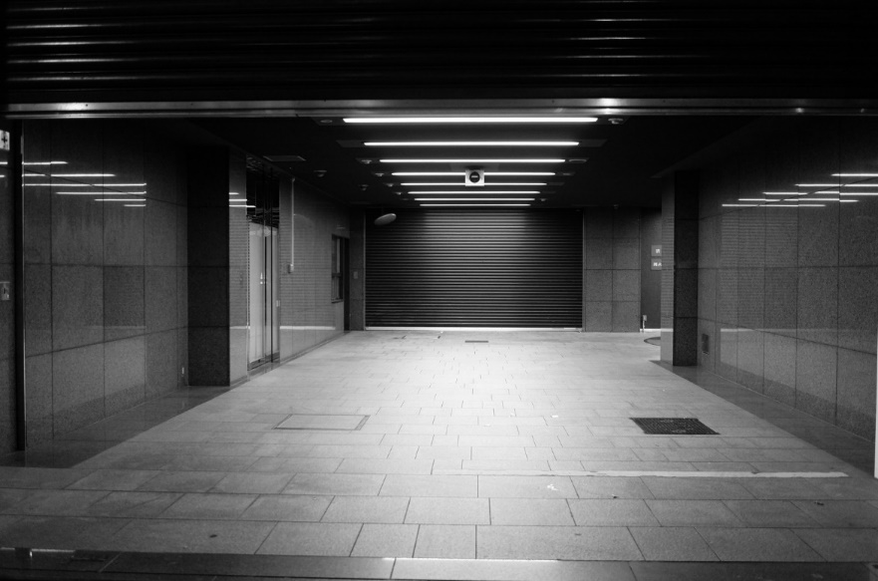
EXERCISE 1 - PHOTOLANGUAGE
PHOTOLANGUAGE
Choose the photo you most identify yourself with

Slide 12
EXERCISE 2 - PARTICIPANTS’ PRESENTATION
Please call me… NAME
YOUR PHOTO
PARTICIPANTS’ PRESENTATION
How do we want to be addressed

Slide 13
E-learning debriefing
We intended to:
Characterize participants’ perceptions about academic integrity
To open the discussion about authenticity, originality, academic integrity, individual and institutional development and innovation
To identify in which stage participants think their institution is regarding the existence of an institutional ethical code
To initiate the reflection on the institutional and individual development plans

Slide 14
Coffee-break

Slide 15
ACADEMIC INTEGRITY
Individual and group/team values

Slide 16
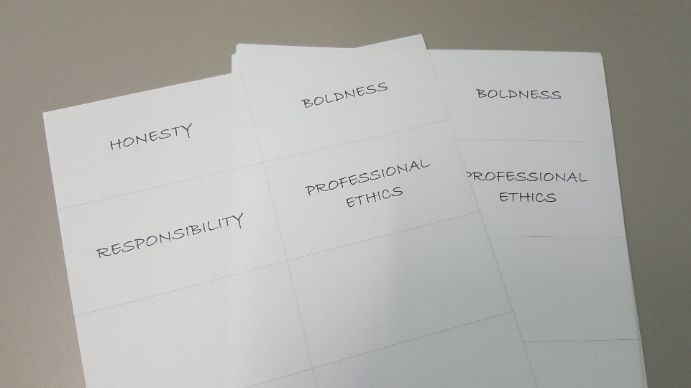
EXERCISE 3 – THE WALL OF VALUES
(Adapted from Korthagen, 2001)
INDIVIDUAL WALL OF VALUES
1. Please select up to 10 values, either from the already filled cards or writing other values on the blank cards, selecting the values that FOR YOU best answer the question:
- Which are the most important values regarding academic integrity?
2. Now, rank the chosen values according to the individual importance given to each value.
- How do YOU RANK them in order of importance?
Create your own criteria: up → down // right → left to organize the cards. You can put more than one value in the same level.
3. Build YOUR Wall of Values: stick the cards to a paper. Put your name on it.

Slide 17
EXERCISE 3 – THE WALL OF VALUES (2)
(Adapted from Korthagen, 2001)
GROUP WALL OF VALUES
1. Present YOUR Wall of Values to the group
2. Now IN GROUP, answer to the question:
Which are the most important values regarding academic integrity?
Select the most important values to the group.
(Use a new set of cards)
3. The values should be ranked according to the importance given by THE GROUP to each value:
- How do you rank them in order of importance?
4. Build THE GROUP’s Wall of Values: use bostik to glue the cards to a paper.
5. Discuss and confront group and individual Walls of Values

Slide 18
EXERCISE 3 – THE WALL OF VALUES (3)
(Adapted from Korthagen, 2001)
DEBRIEFING
Small Group
Reflection on the processes of harmonization and negotiation
Commonalities and differences
Share your discussion with the large group
Large Group

Slide 19
ACADEMIC INTEGRITY
using a fable

Slide 20
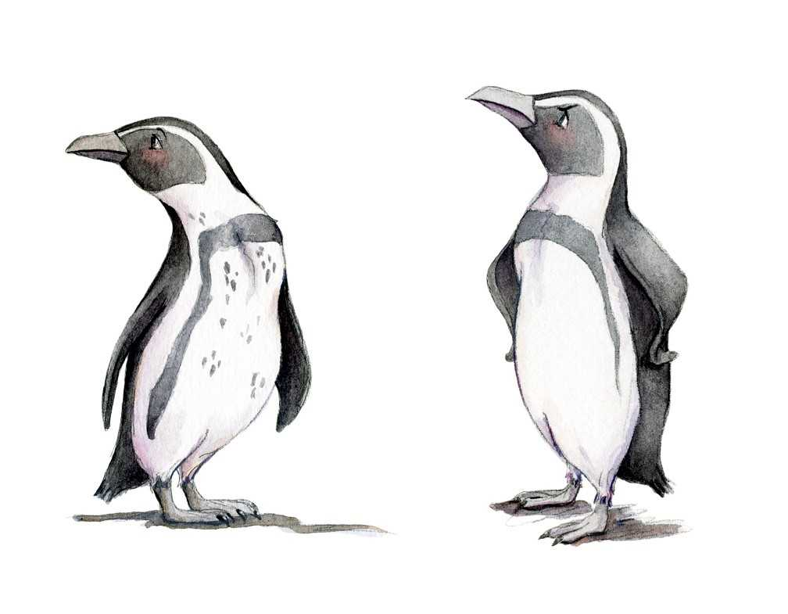
EXERCISE 4 – THE PENGUINS SOCIETY
Read the excerpt from “Our iceberg is Melting” (Kotter, 2006)

Slide 21
Lunch

Slide 22
GROUP/TEAM DEVELOPMENT
Actions, roles, stages

Slide 23
EXERCISE 5 – THE PENGUINS SOCIETY
Choose the character you most identify with
Gallery Walk
Large group presentation of each poster

Slide 24
EXERCISE 6 – DILEMMAS THE PENGUINS SOCIETY
Dilemmas of the main characters
Values used for resolution
Debriefing

Slide 25
EXERCISE 7 – 4 PLAYER MODEL: KANTOR AND ISAACS
MOVER
Ideas
Reviews
Actions
REVIEWER
DEVELOPER
Questions
QUESTIONER

Slide 26
4 PLAYER MODEL: KANTOR AND ISAACS
DEBRIEFING
Purpose of Actions
Move: Direction
Question/ Oppose: Correction
Develop/ Follow: Completion
Review/ Bystand: Perspective
Source: Catherine Louis– Agile Coach Camp – 2010)

Slide 27
4 PLAYER MODEL: KANTOR AND ISAACS
DEBRIEFING
Roles
Diversity of roles
Importance of recognizing this diversity
Each member plays different roles at different times and contexts

Slide 28
4 PLAYER MODEL: KANTOR AND ISAACS
DEBRIEFING
The benefits of a balanced team include:
Inclusiveness: no single point of view allowed to dominate
Repair: the team can recover from imbalances introduced by, for example, a recalcitrant oppose/questioner
Adaptation: team members can responde to change without becoming rigid and defensive
Differentiation: each individual has the opportunity to make his/her contribution
(Source: Catherine Louis– Agile Coach Camp – 2010)

Slide 29
EXERCISE 8 - TEAM DEVELOPMENT
Relations
between the members
of the group/team
Group/Team Performance

Slide 30
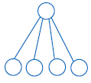
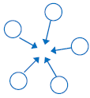
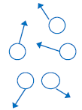
TEAM DEVELOPMENT
Relations
between the members
of the group/team
Interdependence
Performing
Cohesion
Norming
Conflict
Increased group/team effectiveness over time
Storming
Forming
Dependency
Group Team Performance
Orientation to task
Orientation for task
Increased data flow: achieve task
Problem solving

Slide 31
Coffee-break

Slide 32
GROUP/TEAM DEVELOPMENT
Examples of group/team dysfunctions
Lack of commitment
Fear of conflict
Avoidance of accountability
Lack of attention to results
Lack of trust within the group/team
Source: Tuckman’s team development model (1965)

Slide 33
EXERCISE 9 – ACTIONS, RELATIONSHIPS AND IDEAS
Actions
Ideas
Relationships
What can be done to improve the quality of the following team dynamics?
Notes:
Teams work at their best if they are made up of individuals whose qualities balance. If individuals appreciate what they bring to the team, their strengths and weaknesses and what a team needs, they can choose to be flexible in their role to improve the group

Slide 34
DEBRIEFING
Up to 3 Take Home Messages on a piece of paper

